Slide 1

Midterm Project
Proposal
Yida Li

Slide 2
“ PART ONE”
Theme/Concept

Slide 3
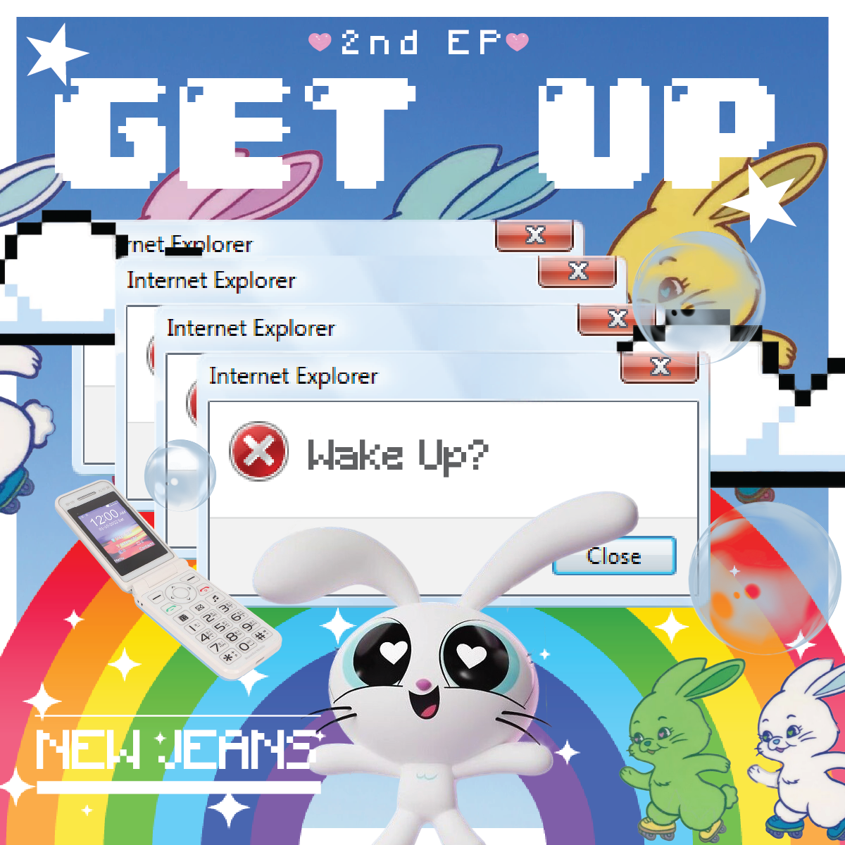
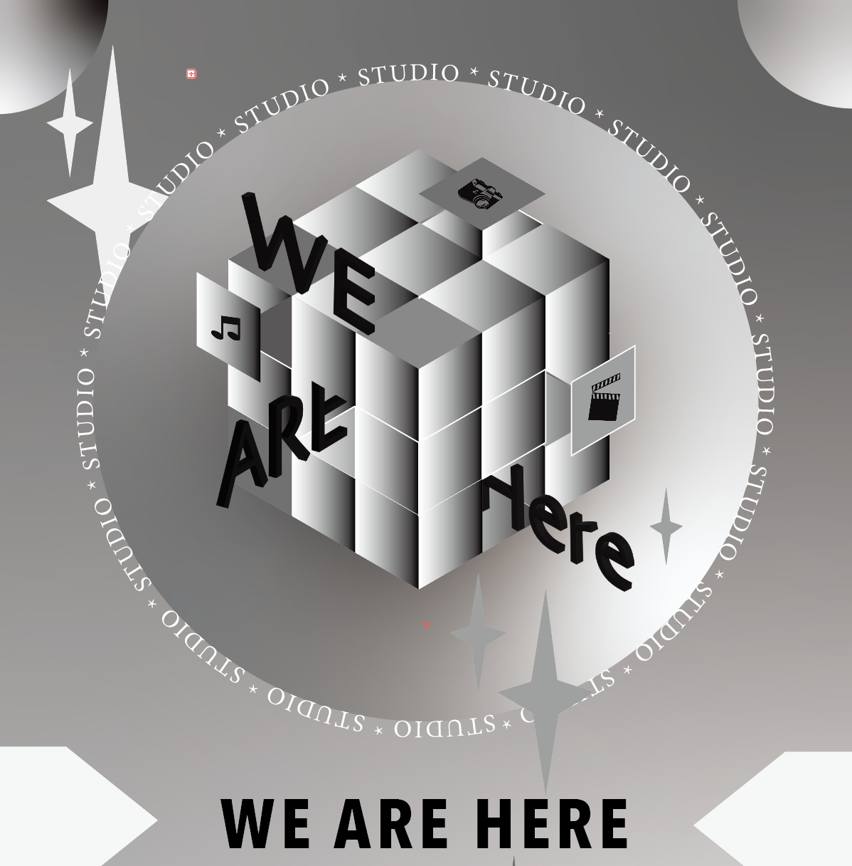
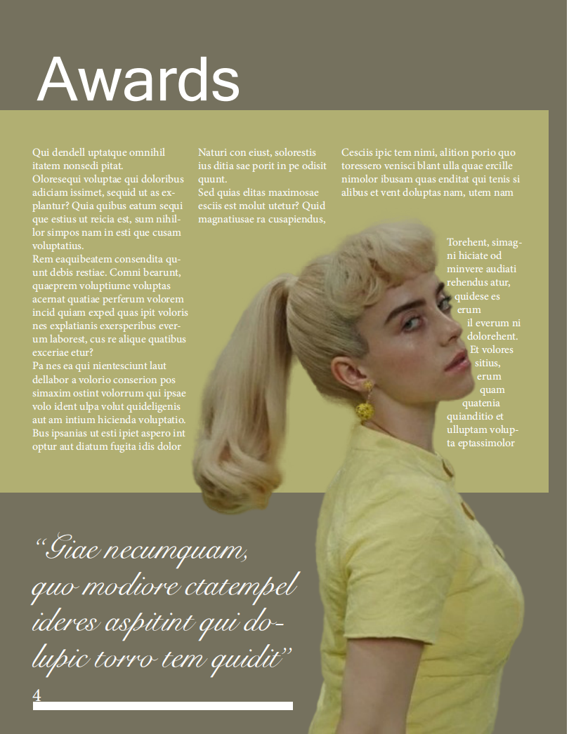
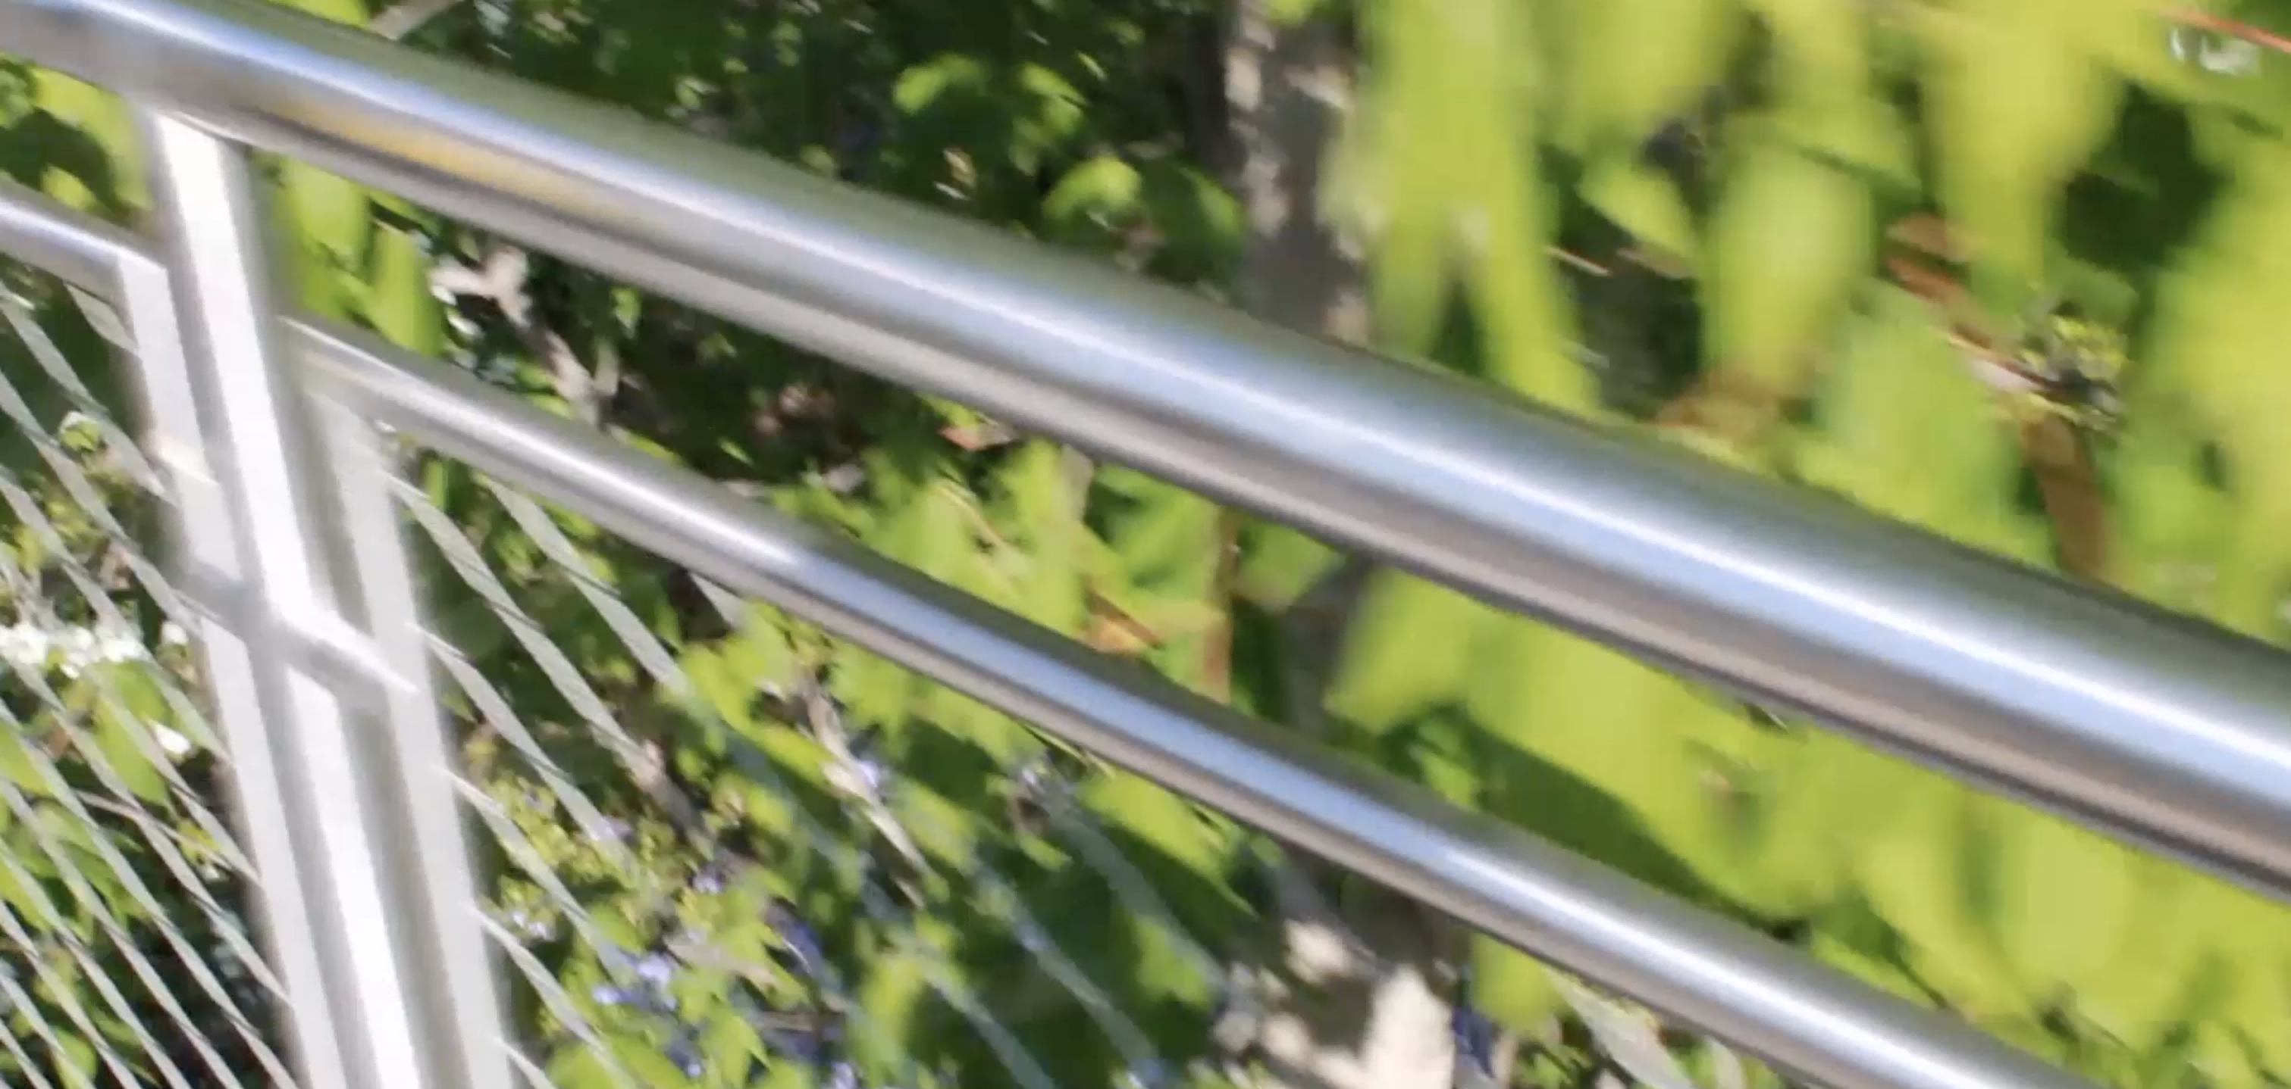
My midterm Project is going to be my personal portfolio, I’m going to put some of my past works on the website, including posters, videos, and some drawings. I’m going to categorize these works into three sections which are 2D works and videos. Also, I’m going to create a homepage for the website.

Slide 4
“ PART TWO”
Inspiration

Slide 5
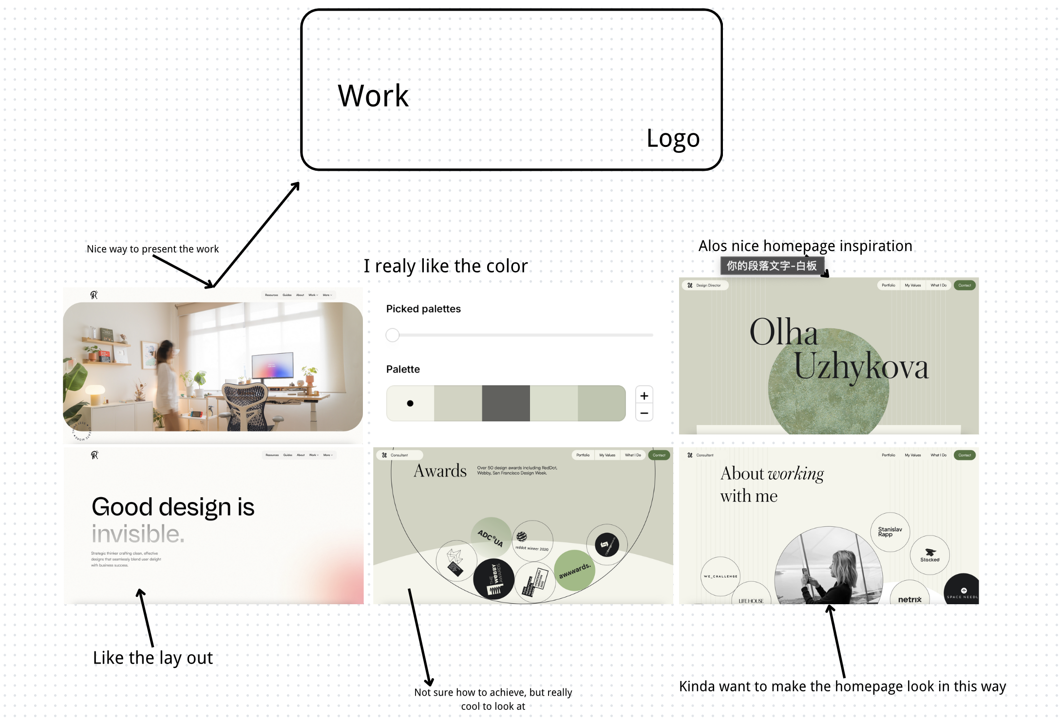

Slide 6
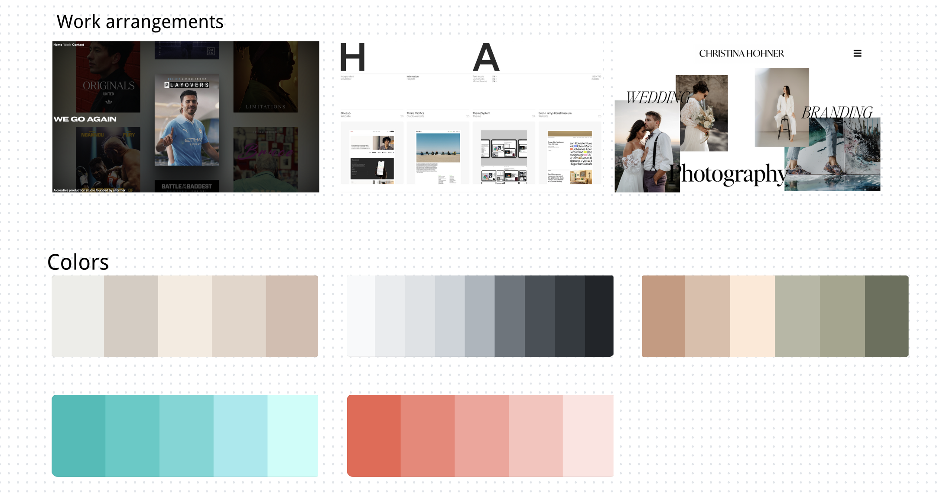

Slide 7
“ PART THREE”
Covered Skills

Slide 8
1. Navigation of the web page
2. Font Settings and size
3. Web page background
4. Image filters
5. Arrangement and placement of text
6. Arrangement and placement of images
7. Color
8. Link images
9. Borders
10. Hyperlinks

Slide 9
“ PART FOUR”
Skills To Learn

Slide 10
1. Image shaping (star, circle)
2. Insert background music
3. Video insertion
4. Graphics settings
5. Use photo as hyberlink

Slide 11
“ PART FIVE”
Wireframe

Slide 12
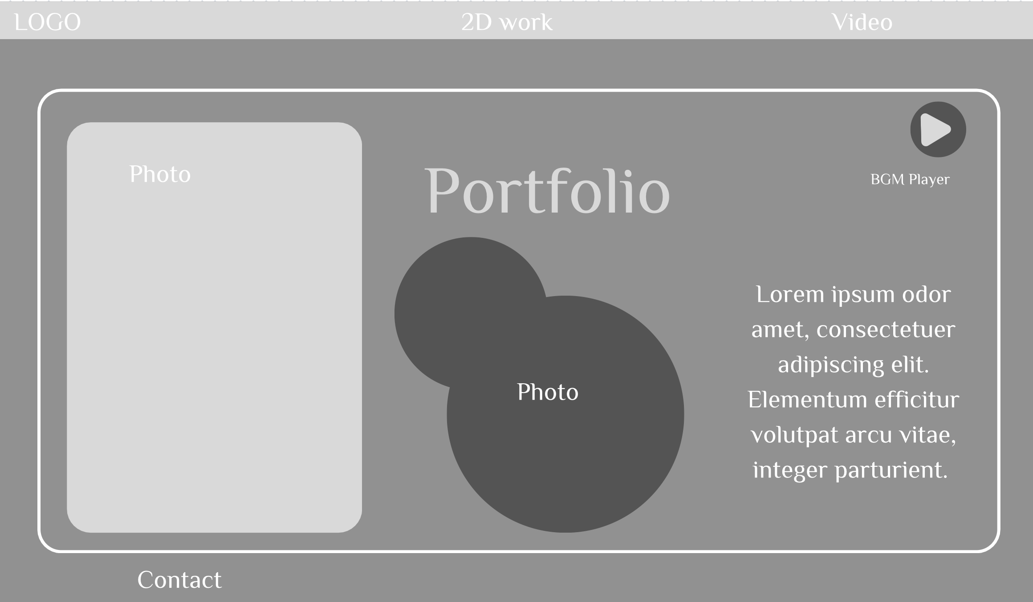

Slide 13
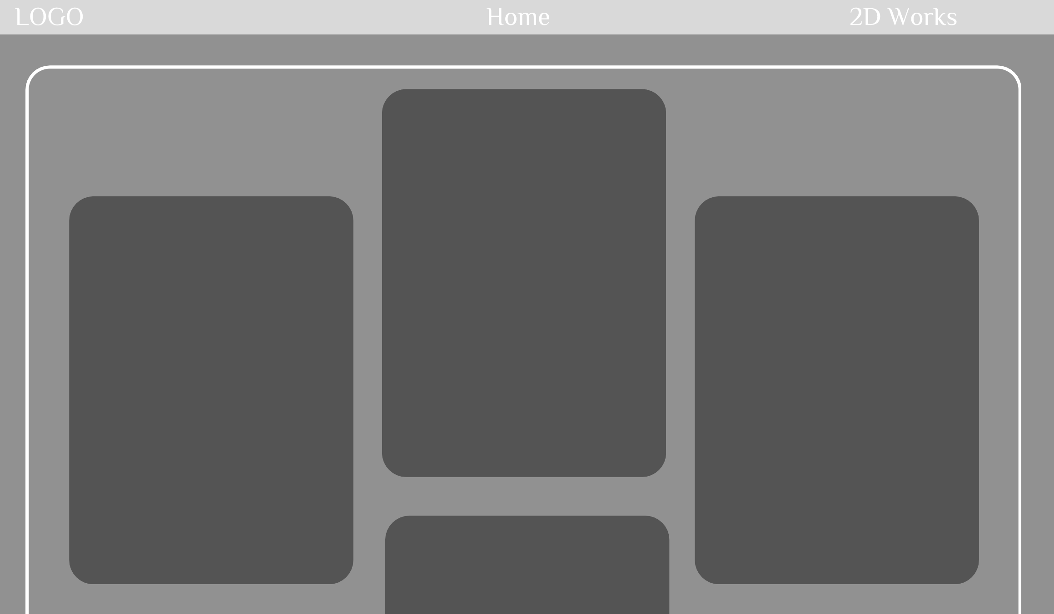

Slide 14
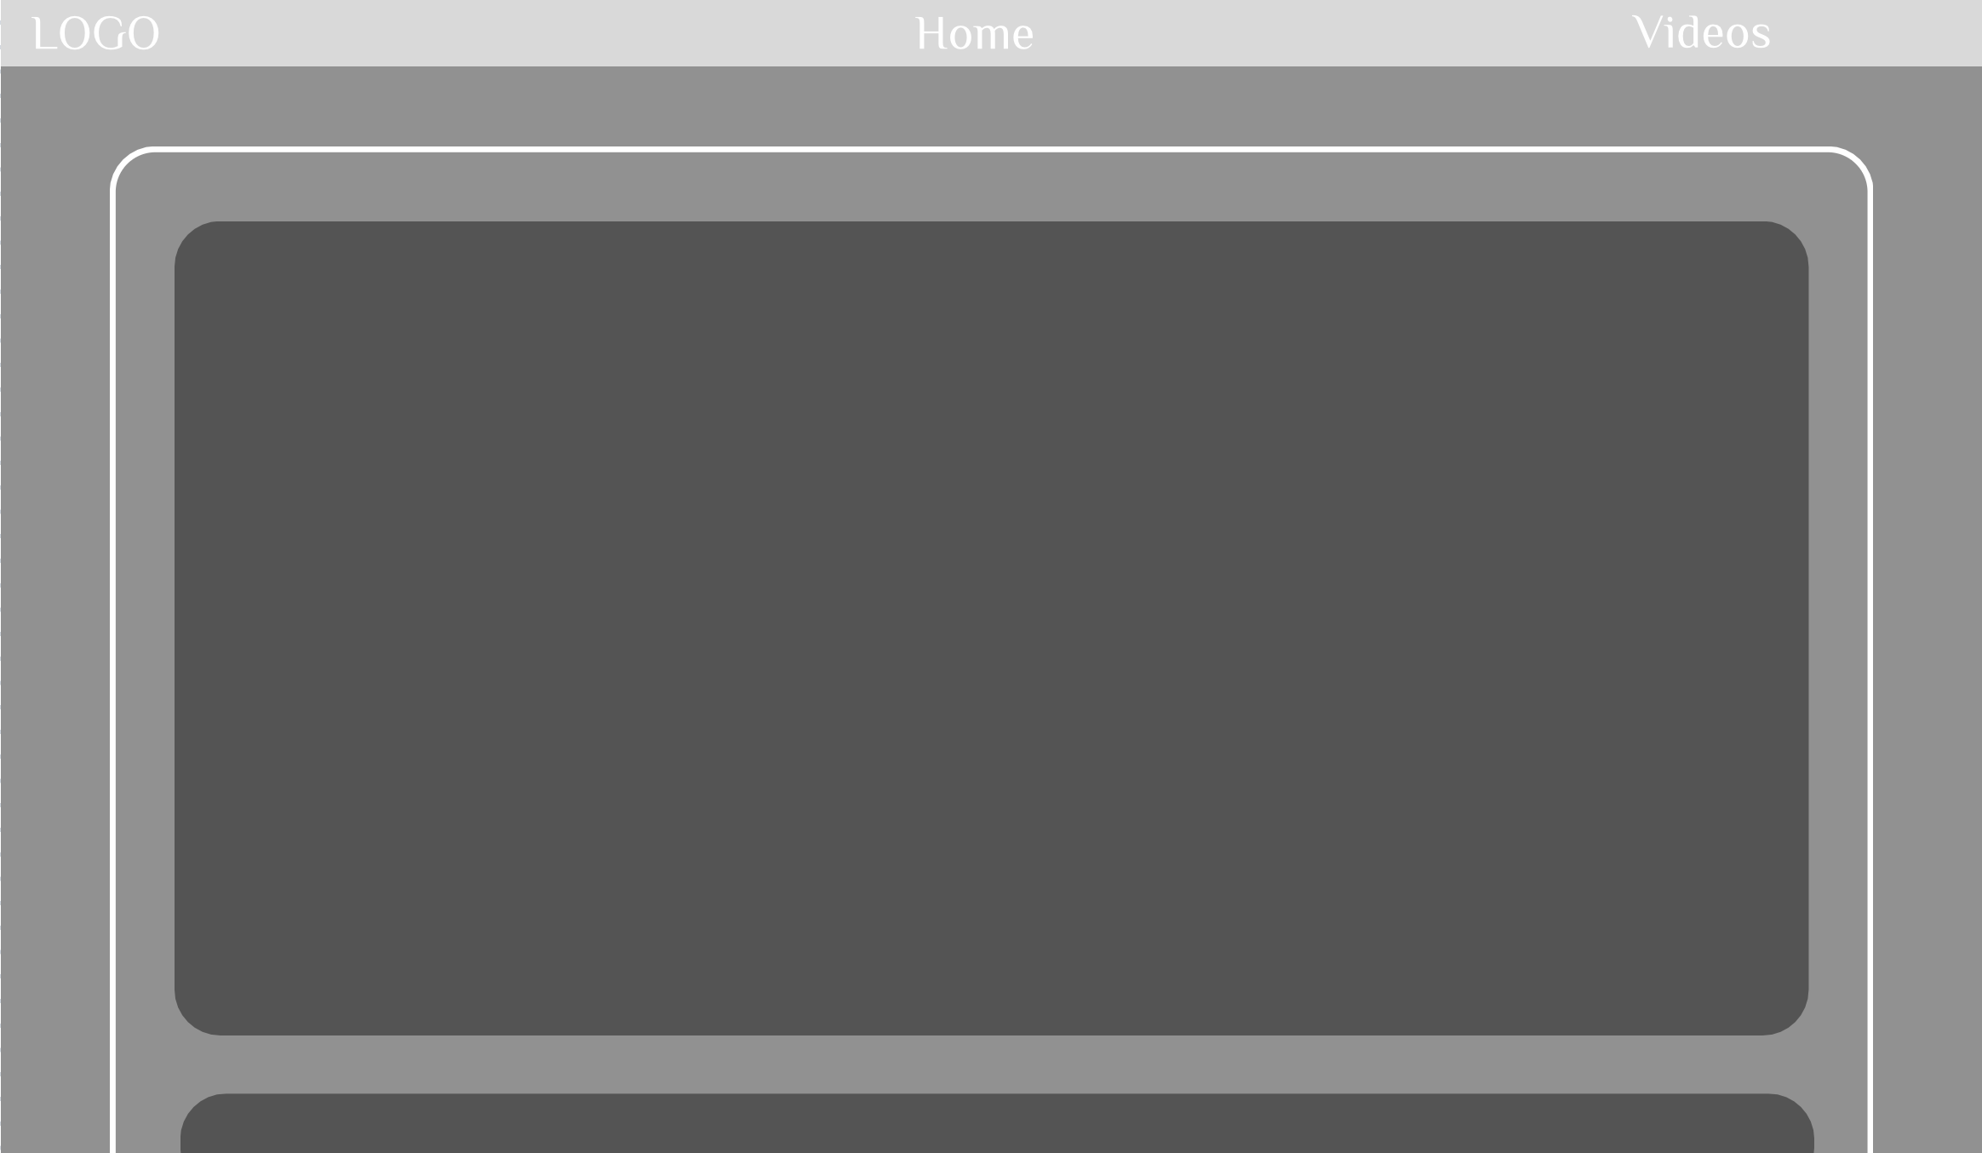

Slide 15
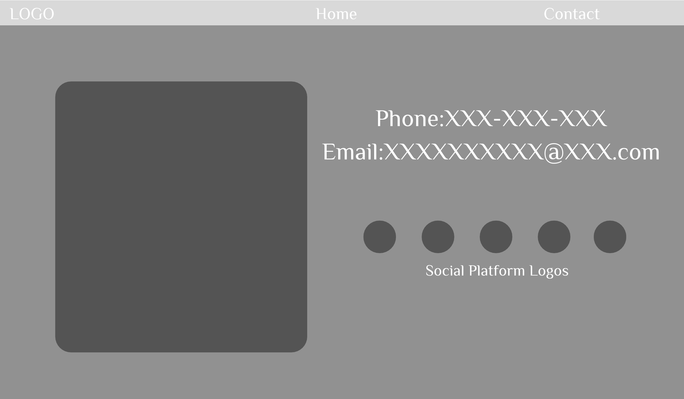

Slide 16
Thanks for listening

